Slide 1

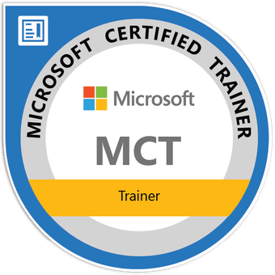


Multimodal AI
How Machines Learn to See, Hear, and Understand Together
Tim Warner
Principal Author | IT Ops | Pluralsight
TechTrainerTim.com

Slide 2
Define multimodal generative AI
Review “80 percent scenario” use cases of how the tech benefits Capgemini and your clients
Explore agentic AI development options in the Microsoft 365 cloud ecosystem
Notes:
Target audience: Mostly beginner.
LLMS: Mainly M365 Copilot, no access to ChatGPT, Gemini Code Assistant for devs, and maybe no internal Claude
They want upskilling, but AI Council’s blocks a lot of them
Multimodal AI > agentic AI
Effectiveness / productivity with Capgemini customer-specific tasks : How to measure the effectivness (Showcase the ROI)
Governance / avoiding bias / data quality
Key considerations for

Slide 3

Session Materials
github.com/timothywarner-org/multimodal-ai

Slide 4
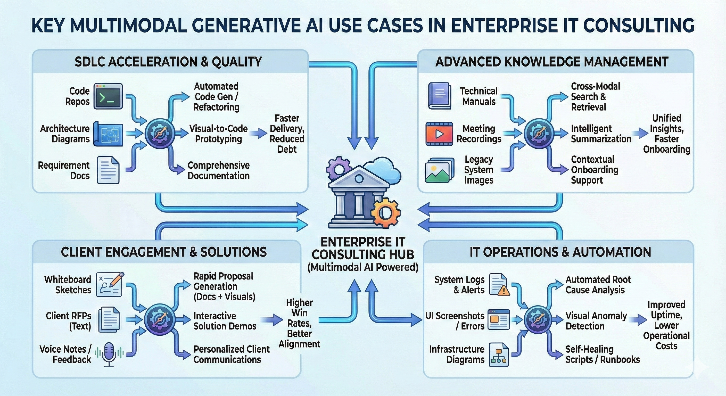
Use Cases & Benefits

Slide 5
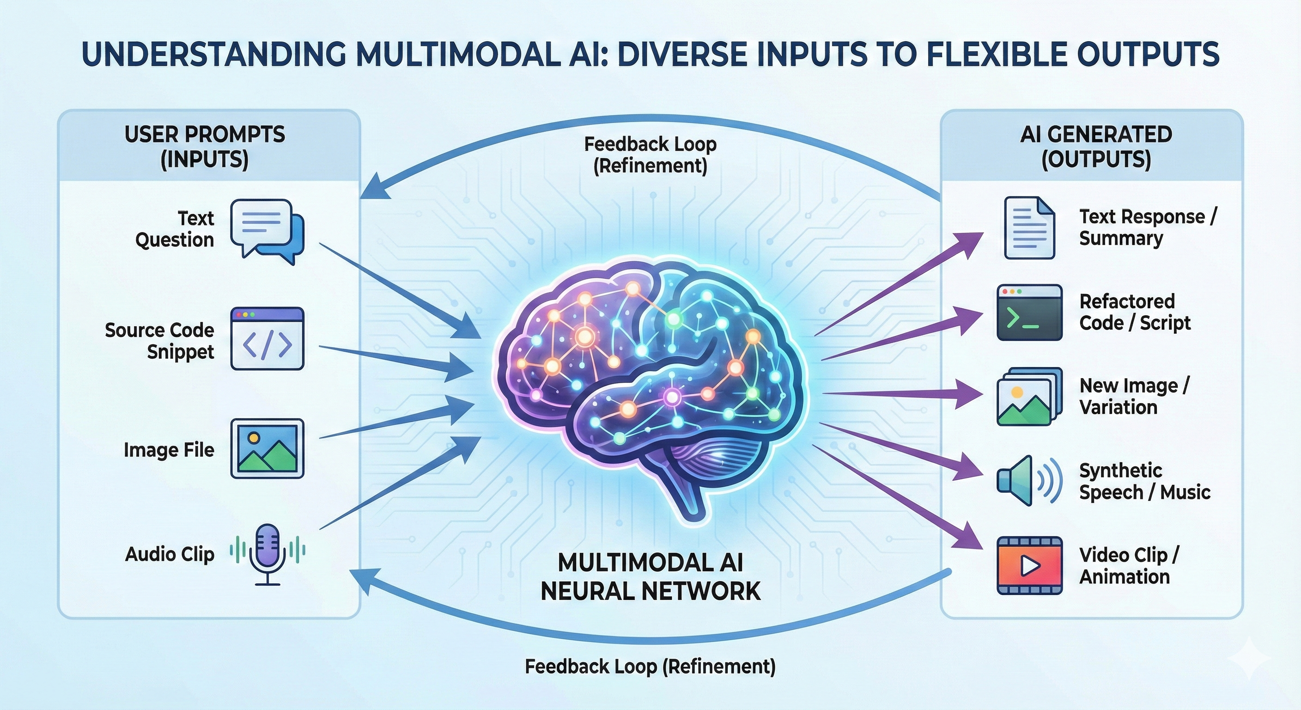
Multimodal Generative AI

Slide 6
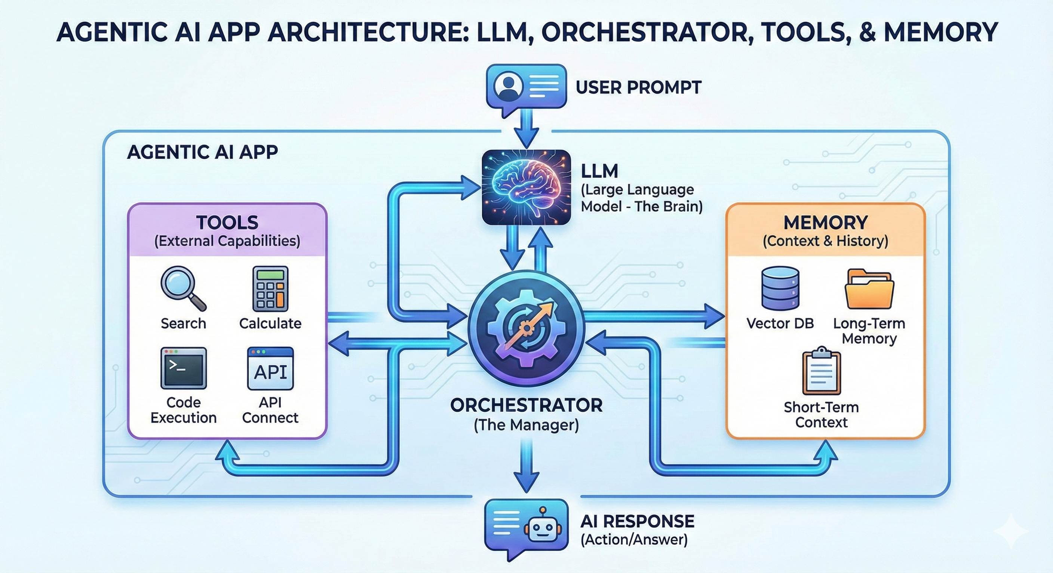
Agentic AI

Slide 7
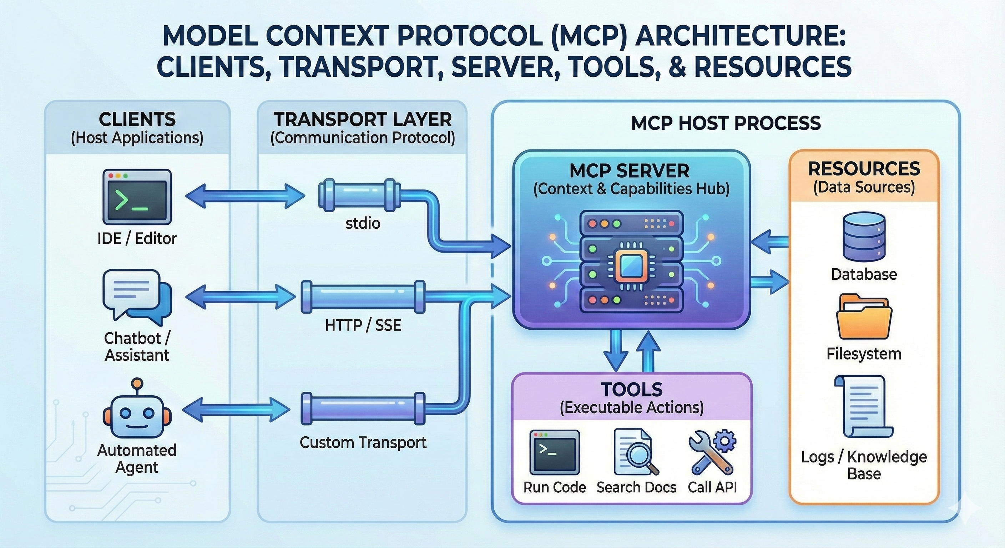
Model Context Protocol (MCP)

Slide 8

Q&A

Slide 9
Thank you for your time!
Tim Warner | TechTrainerTim.com

